Slide 1
Epigenetic Regulation of Maize Gene Expression Responses to Environmental Stress
Carlos Salazar
Majors : Biology & Biochemistry
Mentor: Dr. Madzima
Division of Biological Sciences, School of STEM

Slide 2
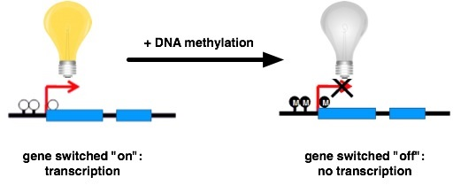
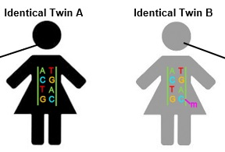
What is Epigenetics?

Slide 3
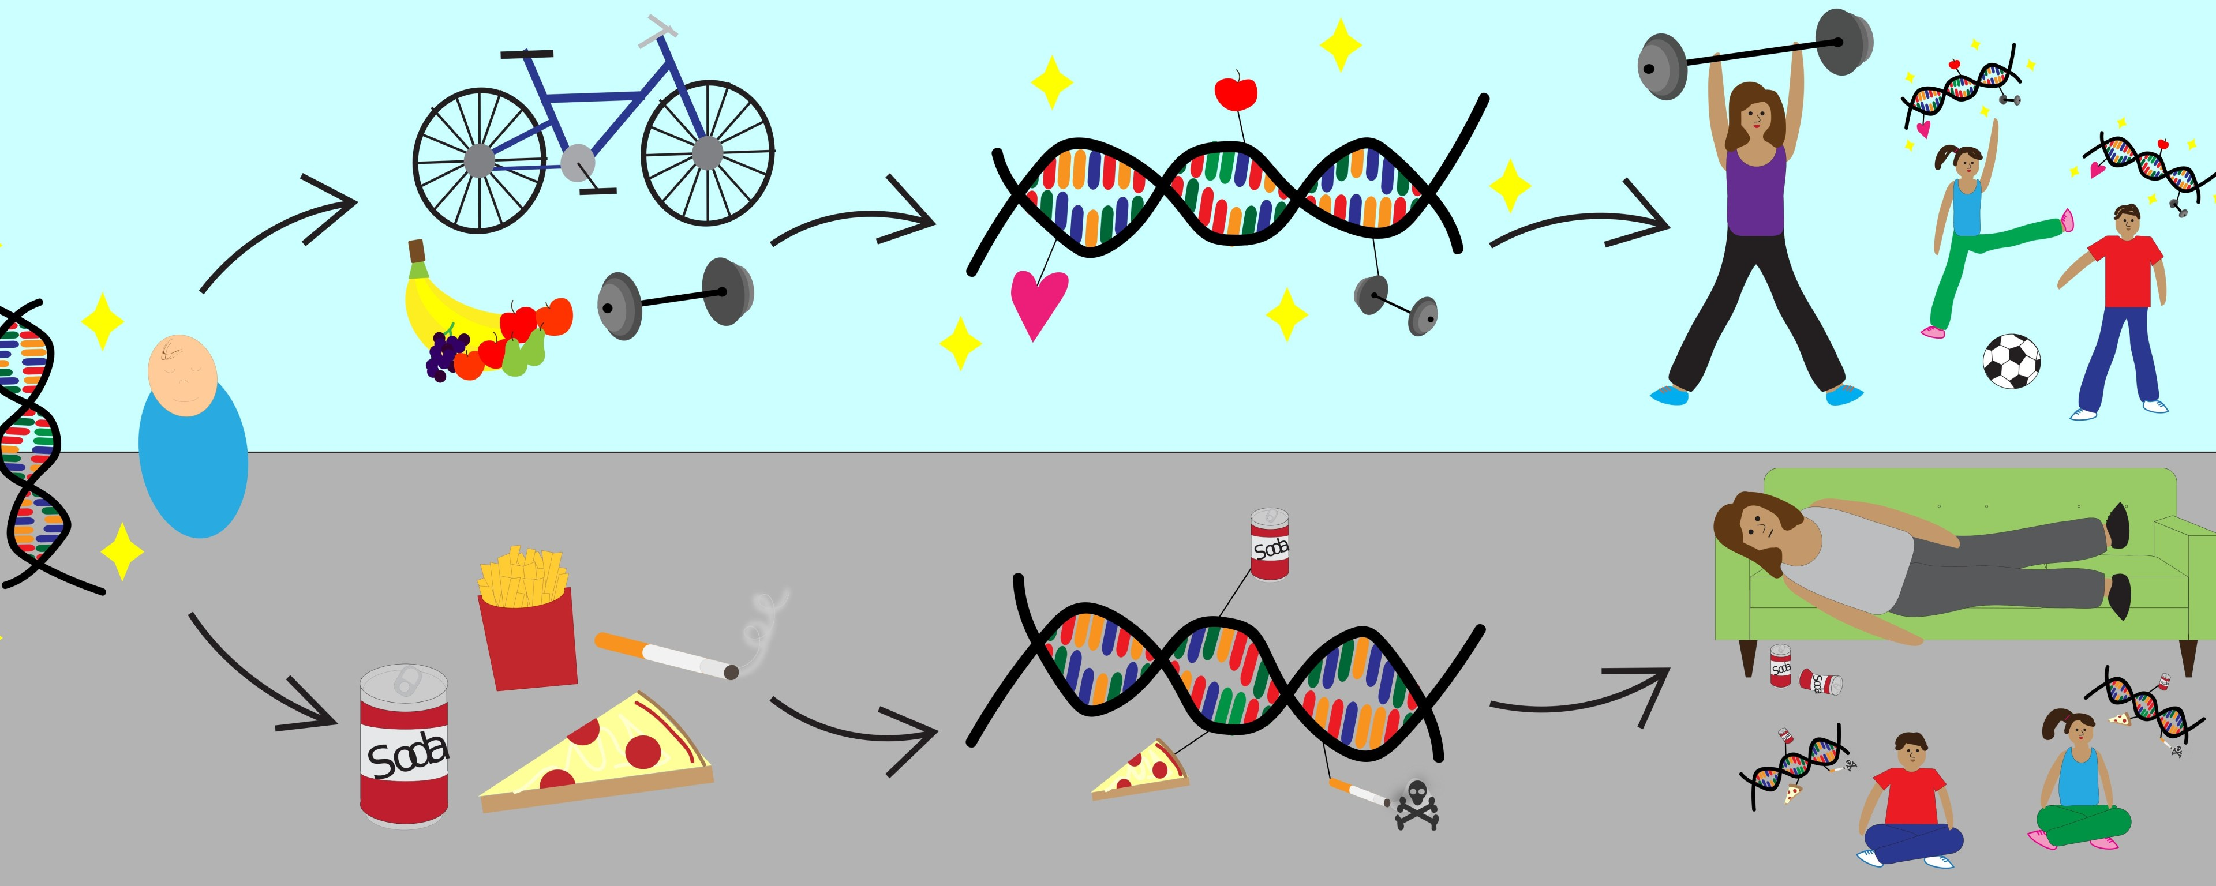
Factors that Affect Epigenetics

Slide 4
Our Protein of Interest Mediator of paramutation1 (MOP1)
Mop1 is RNA dependent RNA polymerase that makes dsRNA.

Slide 5
MOP1 MUTAGENISIS
Part a shows where the lesions happened in MOP1 gene
Part B is showing the insertion that occurred shown in part a.
Mop1 gene has transposable elements in transposon four that disrupts the open reading frame of the gene, rendering It nonfunctional.
MU is mutator transposable element. Mu is added to exon 4, breaks up coding sequence

Slide 6
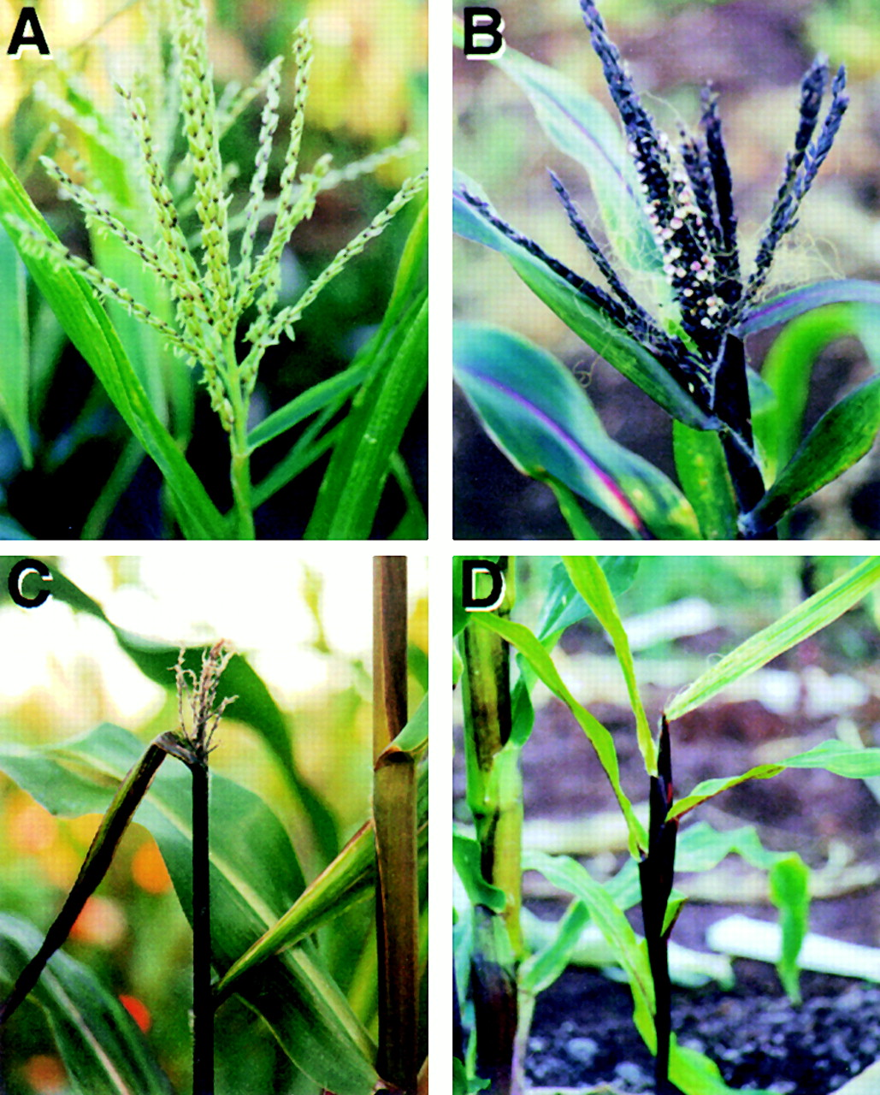
Previous Studies of MOP1 Modifications
Normal tassel
Feminized tassel
MOP1 Protein is important for growth and development
Mutants exhibit pleiotropic developmental phenotypes.
MOP1 directly and indirectly regulates epigenetic expression of many genes.
Mop1 mutation affects plant development
WT
MUTANT
MUTANT
MUTANT
MUTANT
Barren tassel
Failed emergence of a feminized terminal inflorescence

Slide 7

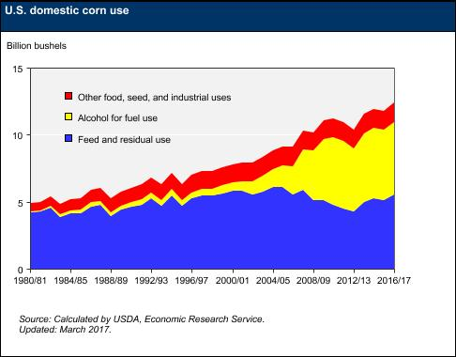
Importance of Maize Research
Food etc.
Fuel
Animal Feed

Slide 8

Question
How this mop1 mediated DNA methylation pathway affects gene expression in maize?
How epigenetics affects plants respond to abiotic stress?

Slide 9
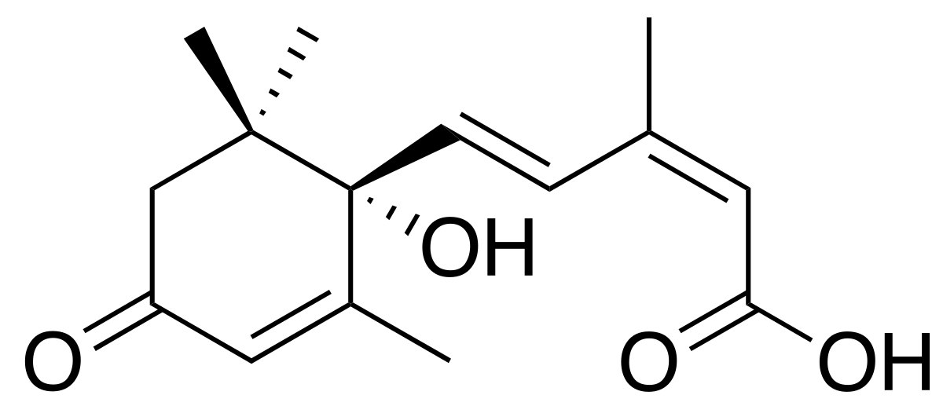
Simulating abiotic stressor
Abscisic acid (ABA) Is a plant hormone that accumulates in response to abiotic stressor.
To understand how epigenetics and abiotic stress affect gene expression Our Mop1 mutants and wild types are subject to induced stress by ABA.
RNA from these samples were subjected to RNA sequencing and bioinformatic analysis.

Slide 10
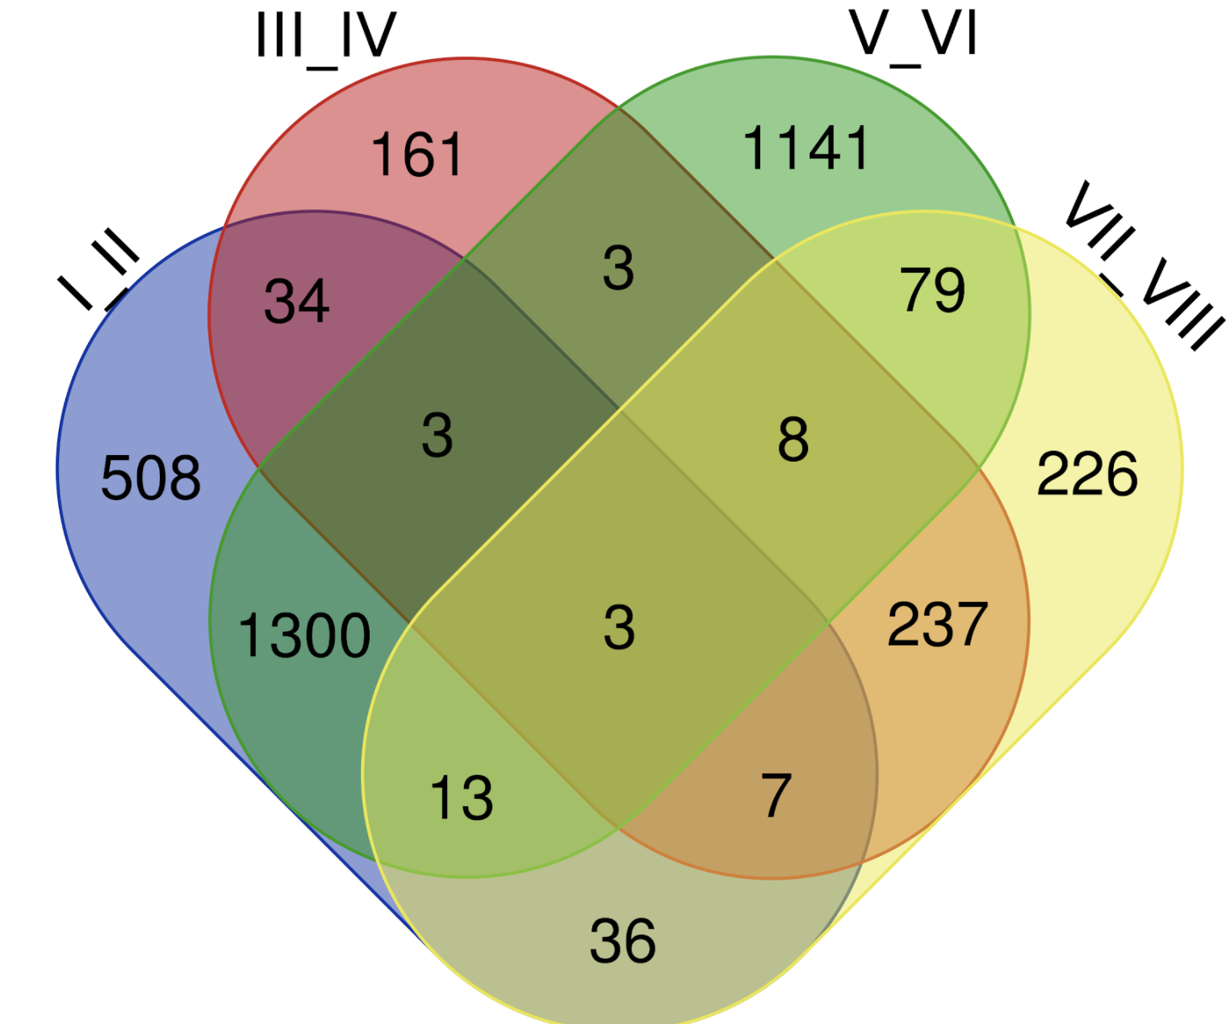
Method
The Vendramin et al study grouped differentially expressed genes Into 4 categories. We chose to analyze the perimeter for overlaps.
Mop1-1 MUT / Mop1 WT
Mop1-1 mut ABA/ Mop1 MUT
Mop1 WT ABA / WT
Mop1-1 mut ABA/ Mop1 WT ABA

Slide 11
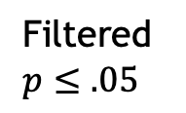
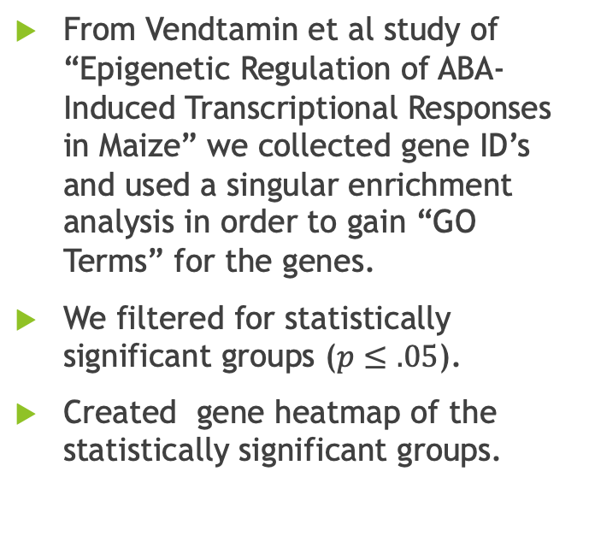
Method
From Vendtamin et al study of “Epigenetic Regulation of ABA-Induced Transcriptional Responses in Maize” we collected gene ID’s and used a singular enrichment analysis in order to gain “GO Terms” for the genes.
We filtered for statistically significant groups ($p≤.05$).
Created gene heatmap of the statistically significant groups.
Collection of genes
GO terms
Heatmap
SEA analysis
Filtered $p≤.05$

Slide 12
Results

Slide 13
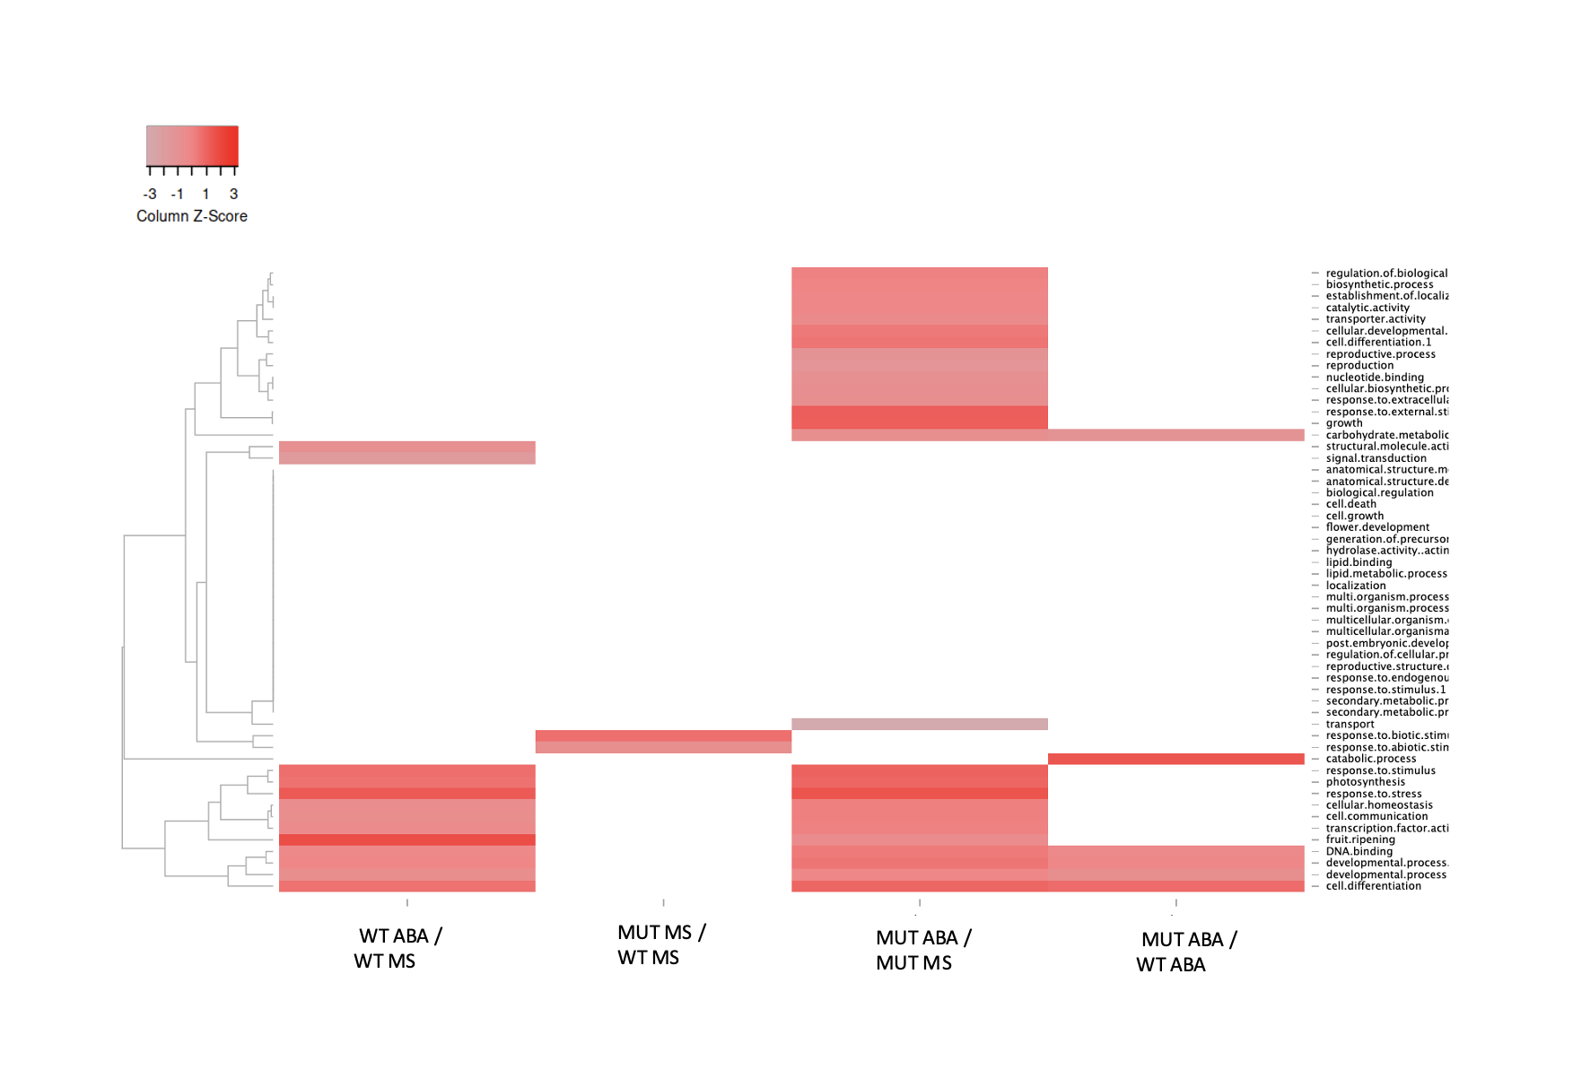
Results

Slide 14
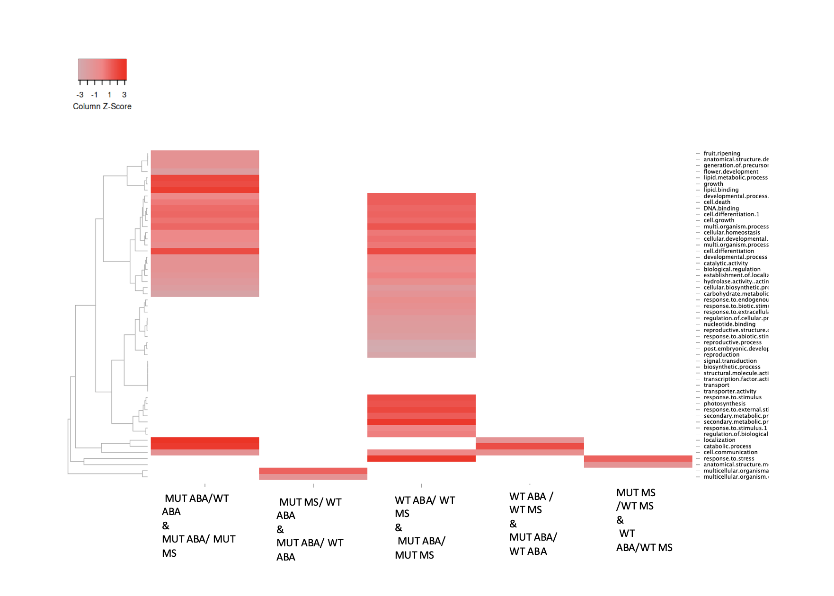
Results

Slide 15
Key findings

Slide 16
Conclusion

